Slide 2
NMBU
Quality Assurances System. Where we came from and where we are now
Department of Academic Affairs, Head of Unit Iben N. Andersen
10. March 2016

Slide 3
Where we came from
1859 – The Higher Agricultural College
1897 – Norwegian Agricultural College (NLH) – under Ministry of Agriculture
1994 - Common Law for HI. NLH new “owners” Norwegian Ministry of Church and Education
2000 – Mjøs utvalget (NOU 2000:14) Freedom with Responsibility
2002 – NOKUT is established
2003 – New law for HE – Quality Reform to comply with the Bologna process.
2005 – NLH’s QA system is approved and NLH is accredited as a University
2010 – NOKUT re-approve UMBs QA
2012 - National Qualification Framework (NQF)
2014 – UMB emerges with NVH and NMBU is born
Notes:
Our Journey
This process is intended to take place throughout Europe to better integrate the higher educations systems, and Norway is among the first to implement this process. The Norwegian approach was a quick and brutal removal of the old system and replacement to the new instantly.
Mjøs utvalget was a political frontrunner for the Quality Reform and the Bologna process in Norway.
One outcome of the report was introduction of a new financial system for the universities and Colleges. The HEI institutions got part of their funding as a result of the amount of credits produced. The idea was the institutions should compete about the students and follow the students closely.
NKR describes learning outcomes in terms of knowledge, skills and competence, in other words, what a person knows, and is able to do after training. NKR is based on the formal education system and there is currently only qualifications acquired through education system which is embedded at levels in the framework
The first QA was very extensive massive, it covered every detail.

Slide 4
Bologna process
European Objectives | Norway and NMBU
Adopt the international standard of comparable degrees | Bachelor and Master - 2004 (3+2+3)
Establish a common system of credits - ECTS | ECTS and new grading system - 2004
Increase student mobility and international cooperation. Recognition of qualifications | Internationalization of research and education, new agreements, more mobility, Erasmus
Promote European co-operation in Quality Assurance | Developing a QA system - conditional
Students participation in all levels | Increased involvement by students in all university bodies
Academic Autonomy | Authorisation to establish and terminate study programmes
Notes:
Other changed included replacing the former number scale (from 1.0 to 4.0) grades to A to F letter scale, reducing the number of passing grades from 41 to five. It also changed the former system credits of vekttall
The process of measuring quality must follow established methods. Therefore, quantitative collection of statistics is currently the most important instrument for assessing quality. The incentives in the financing system related to the production of academic credits and the system for evaluating performance within research are objective dimensions that can be quantified.
However, these quantitative indicators are supplemented by more qualitative assessments through the monitoring and evaluation of individual educational programmes and institutions carried out by the Norwegian Agency for Quality Assurance in Education. Taken together, this provides an overview of quality to the extent it is currently possible to measure it.

Slide 5
Academic Autonomy
Refers to a university’s capacity to manage its internal academic affairs independently
Overall student numbers
Admissions procedures Introduction of programmes at all levels
Termination of degree programmes
Language of instruction
Selection of quality assurance mechanisms
Selection of quality assurance providers
Notes:
The universities got freedom create and terminate study programmes
Whether the programme should be taught in Norwegian or English

Slide 6
Development of NMBUs QA system – for both controlling and provide development
001: 2004-2008
Procedures for course and study program approvals, criteria for approval
Course evaluations of all courses
External study program evaluations
Follow-up in the Education Committee and Academic Board
Increased student participation in NMBU bodies
Annual Report on Quality of Education
Yearly dialogs with all Faculties and the Ministry
Notes:
To develop the first QA system very many working groups were set down each with a different mandate
- routines for admission
Approval of new courses, programmes
The new credit system
The grading system etc
All working groups had members from the central administration, scientific staff, student counsellors AND students.
Digital Course evaluations was introduced for all course after every time the course was given. The
External evaluations of study programmes.
All findings was followed up by Education committee and the Department boards
And followed up by yearly dialogs with rector, directors etc…
The newer QA systems are have been improved and have less focus on controlling and more focus on development and learning outcome.

Slide 7
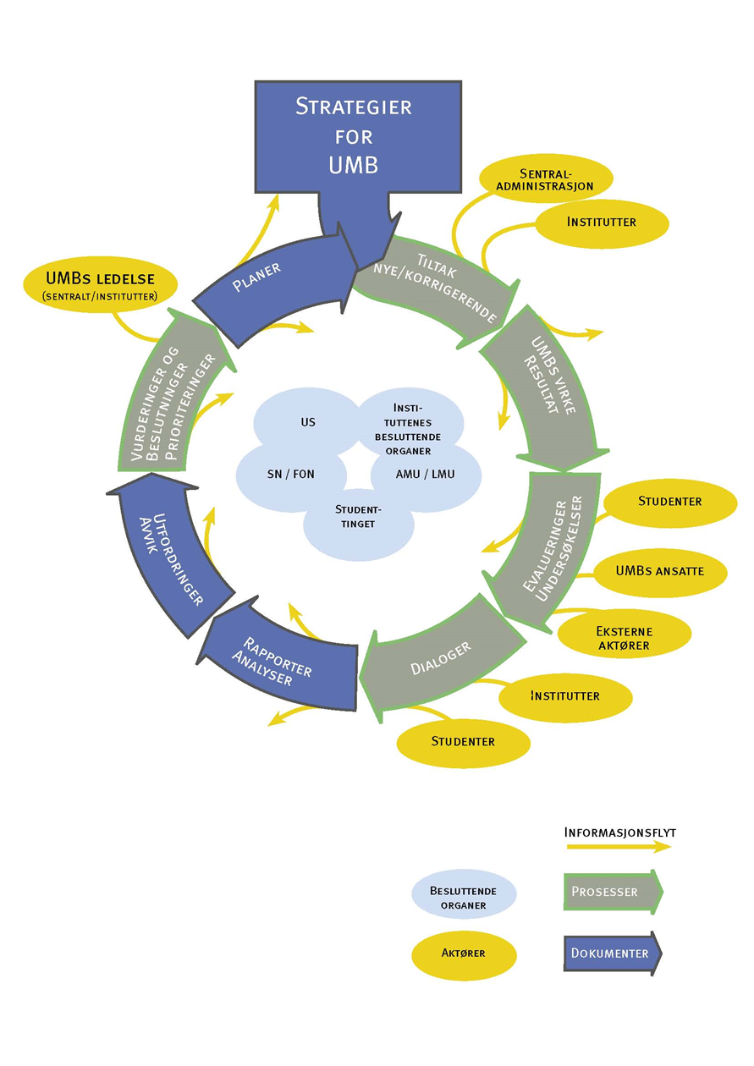

Slide 8
Means of Developing the QA System
Candidate Surveys
Systematic contact with the labour marked
National and international surveys and evaluations of study programmes
Studiebarometeret (NOKUT)
Shot-Survey - Norway's largest survey on students physical and mental health and well-being
National Statistics (DBH)
Student participation at all levels
Very many routine descriptions was created
Notes:
Studiebarometeret contains information from the national student survey about quality of education.

Slide 9
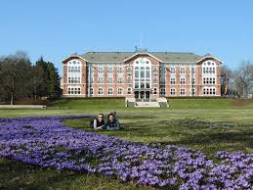
Students have a key role in the processes of developing the University
Students give feedback in various evaluations and are continuously in dialogue with the faculty / lecturer
Contribute through representatives in all university bodies
Two student representatives in the University Board
Work actively in student democracy
Students are a driving force in development and innovation
Notes:
Norwegian students have a very important role at Norwegian institutions.

